Slide 1
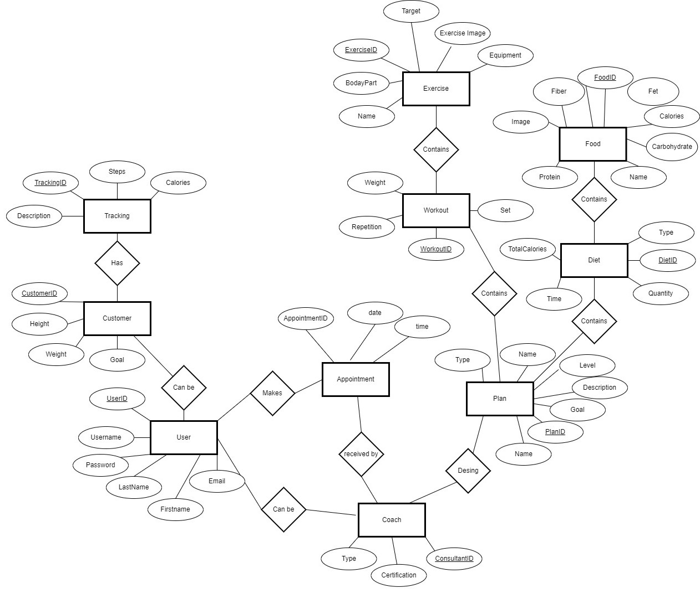
Conceptual ER Diagram I4 Scope Health Application

Slide 2
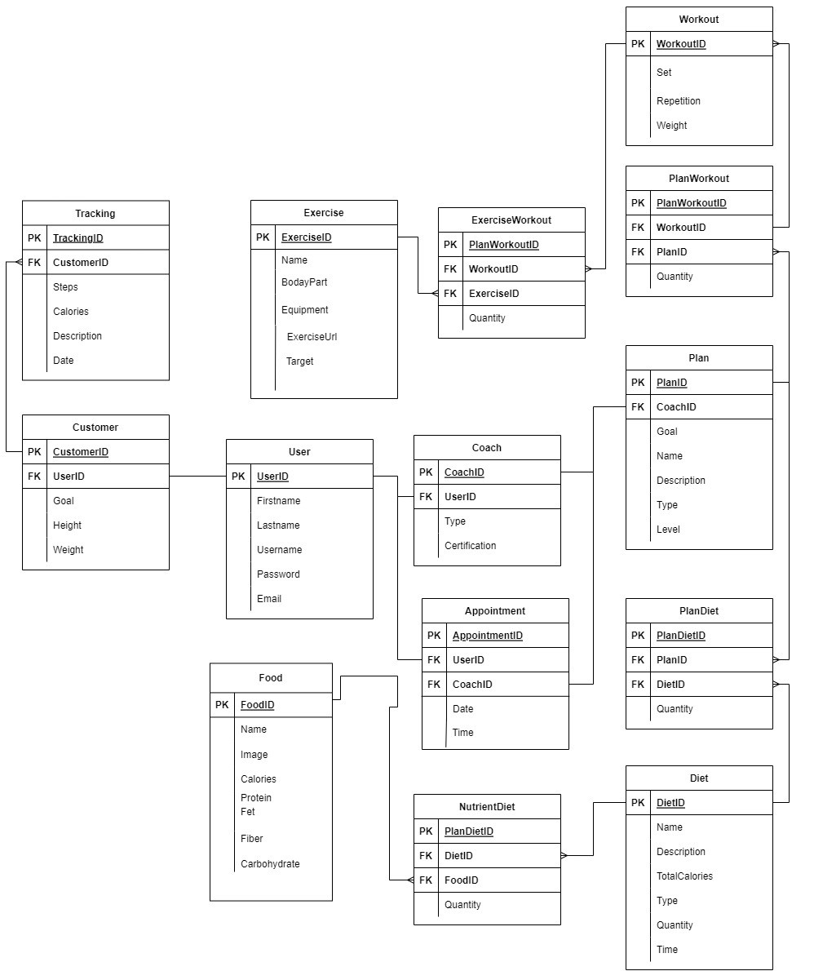
Logical ER Diagram​​– I4 Scope Health Application

